Slide 1
Camera Calibration
Brevin Tilmon

Slide 2
Main idea
We want to undo lens distortions so “pixel i, j” is where we the image says it is in 3D space.

Slide 3

Why? - Accurate 3D Reconstruction

Slide 4
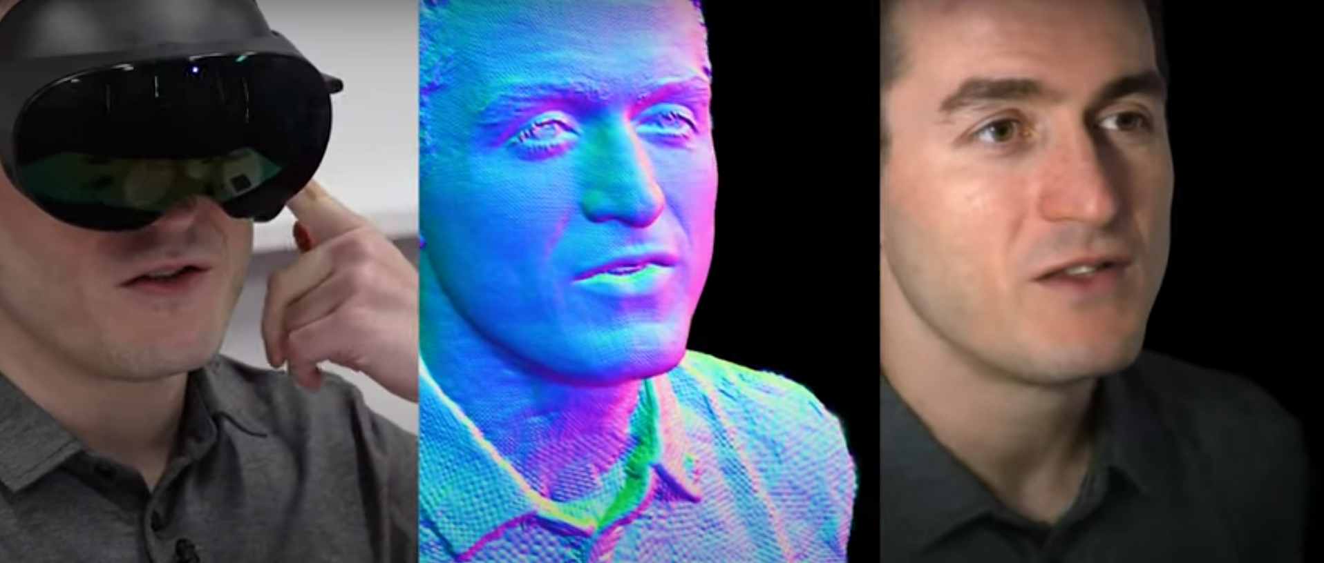
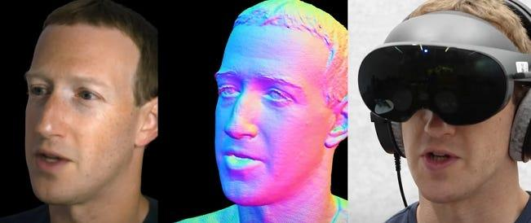
Why? - Accurate 3D Reconstruction

Slide 5
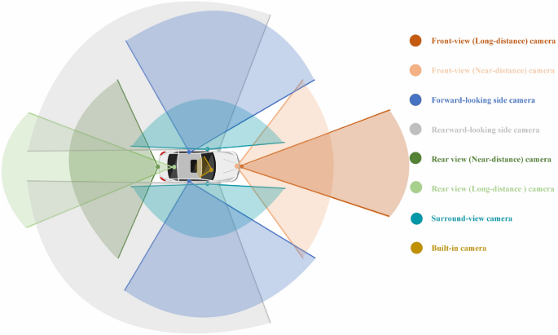
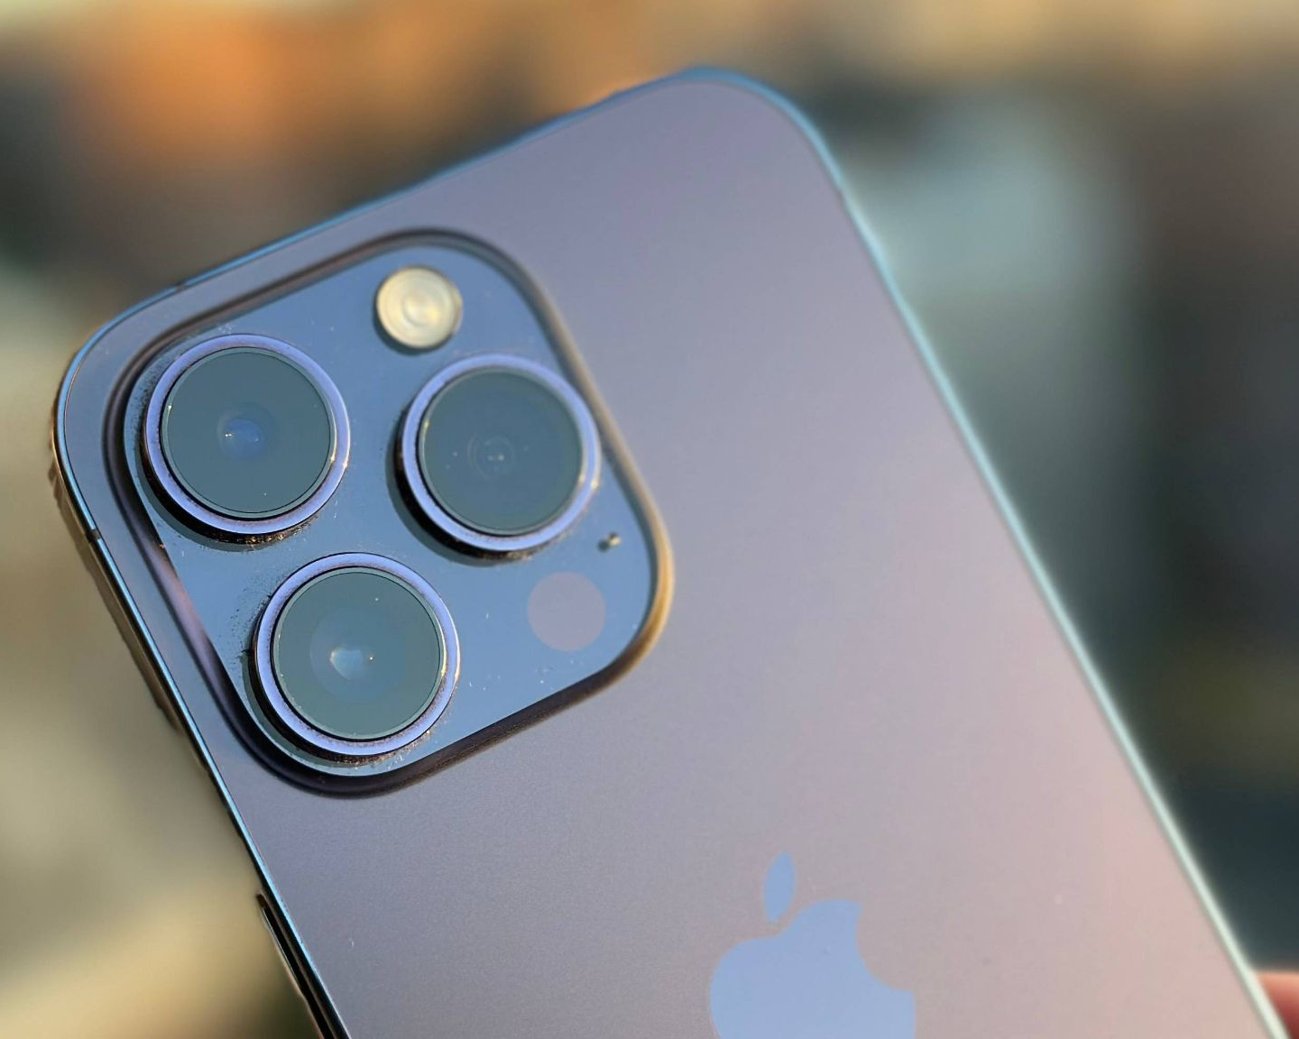
Why? - Multi camera systems

Slide 6

Example

Slide 7
Main idea
We want to undo lens distortions so “pixel i, j” is where we the image says it is in 3D space.

Slide 8
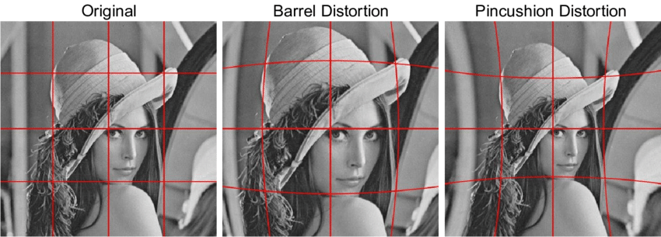
Lens Distortions

Slide 9
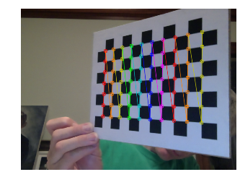
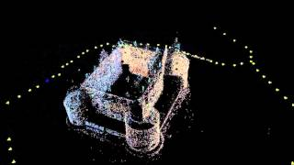
How to undo lens distortions?
Two ways:
Use an object of known 3D shape (this lecture)
Use Structure from Motion (all you need is camera, it is harder, more mathy)

Slide 10
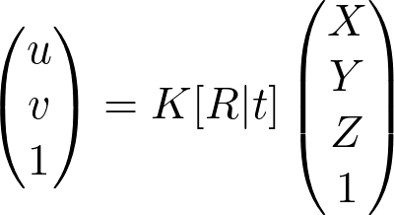
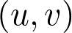
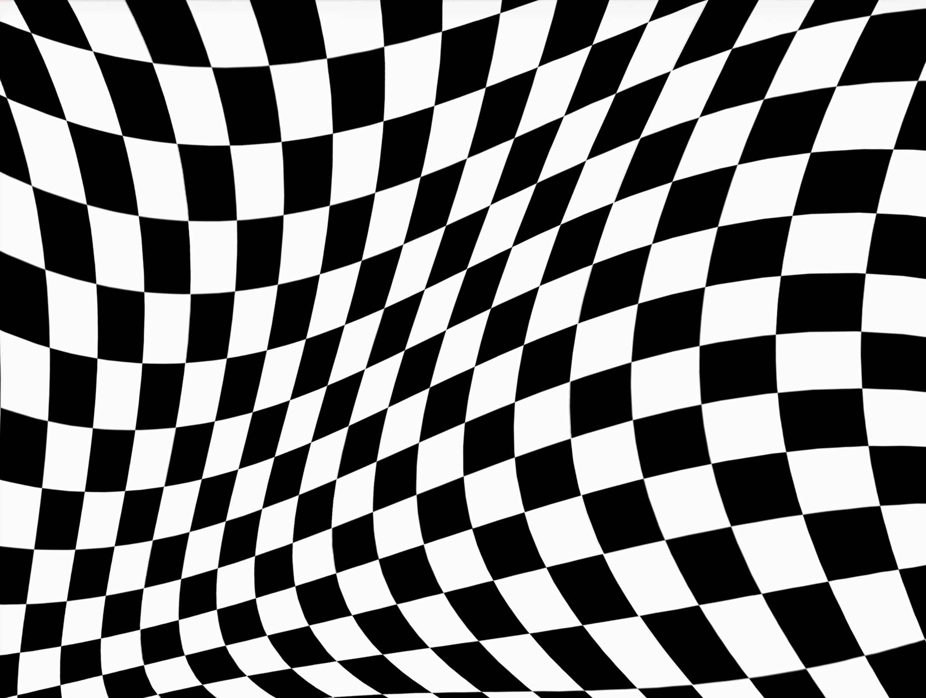



Checkerboard Calibration
We know these from corner detection
We know these because we measured the checkerboard

Slide 11
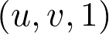
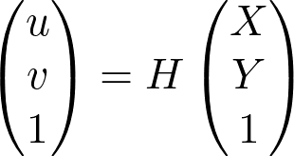
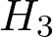
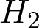
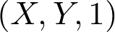

Checkerboard Calibration - Tricks
Since we use a checkerboard plane, Z = 1 and we can use homographies for simpler optimization

Slide 12
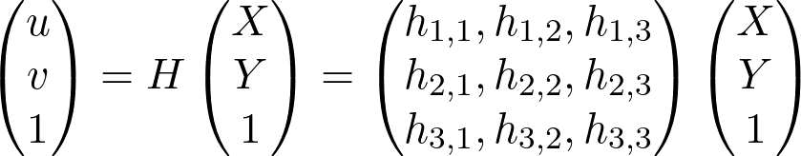
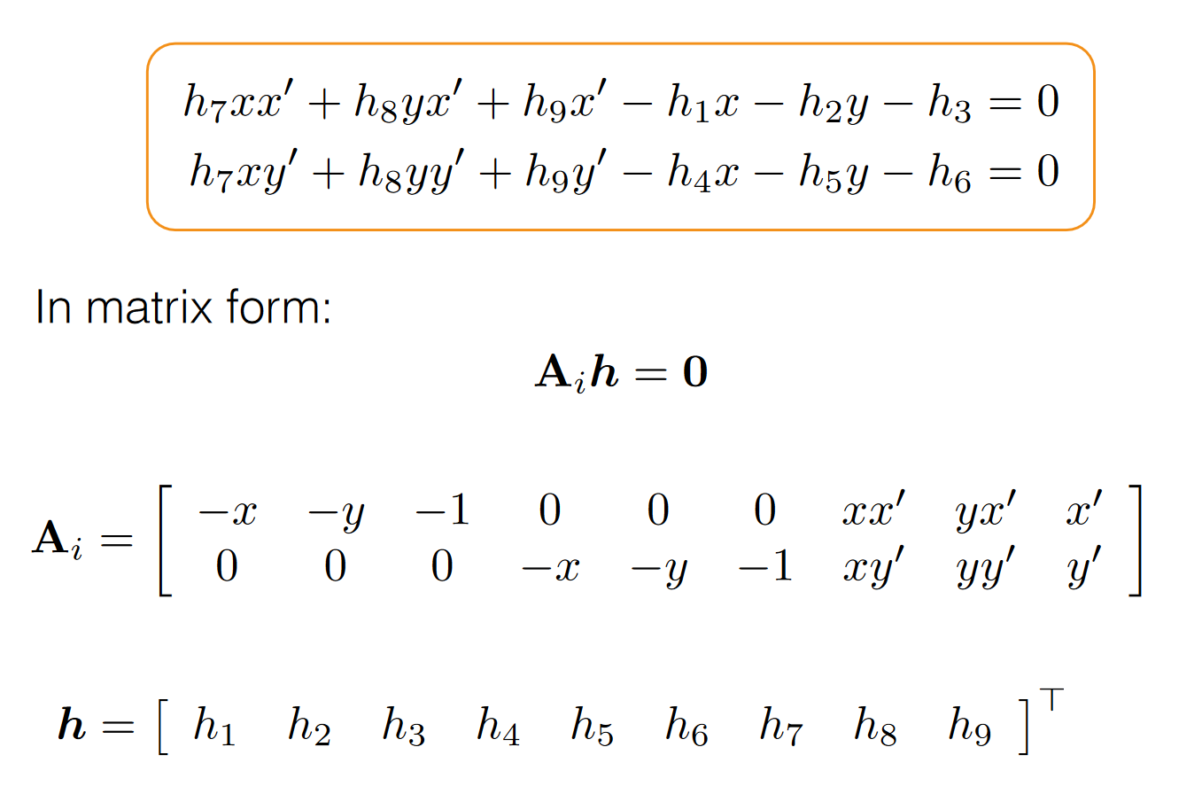
Checkerboard Calibration - MATH!!!
Multiply out the equation (H is 3x3)
Move all terms to one side and set to 0
Solve system of equations through singular value decomposition

Slide 13
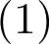
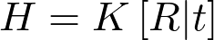
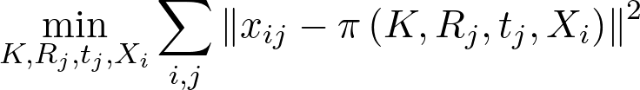
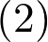
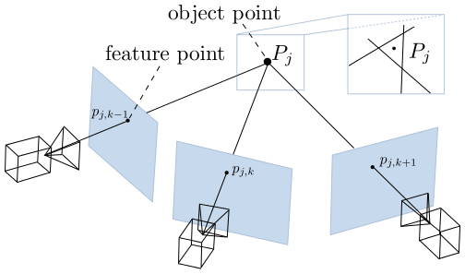
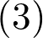
Checkerboard Calibration - Refinement
We have an initial estimate for telling us how the camera is distorting the 3D points. Now, we refine the estimates using a simpler version of structure from motion called bundle adjustment with non linear optimizers such as levenberg marquardt.

Slide 14
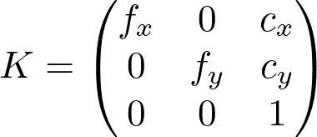
We’re done!
Now that we solved for H, and by extension K (our lens matrix), we can accurately project 3D points into the camera.

Slide 15
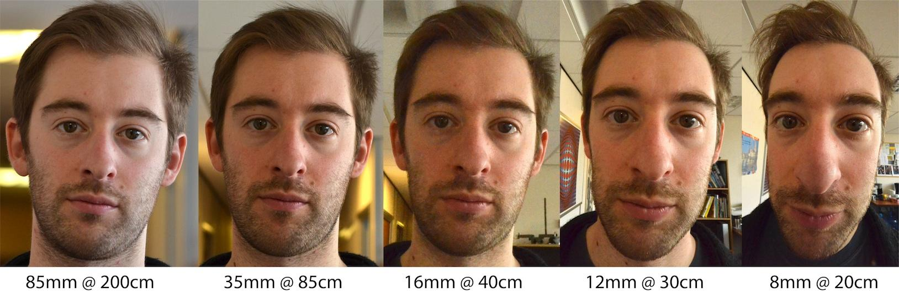
Bonus (perspective distortion, not lens distortion)
Zoom

Slide 16
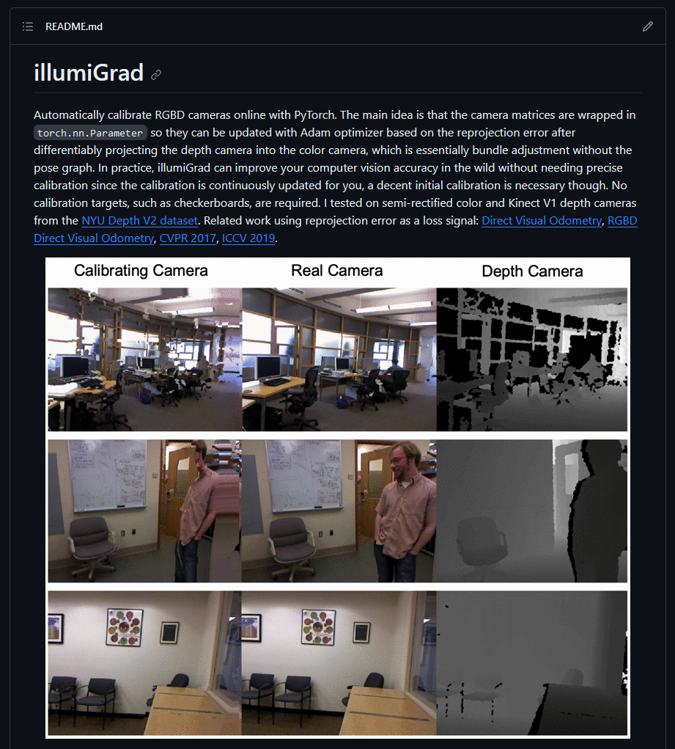
Bonus - Using depth camera to calibrate color camera

Slide 17

Time to code

Slide 18
Assignment
https://drive.google.com/file/d/1JkFF8qhCipuI0tk3ZOqWtDkWKB33kVOF/view?usp=sharing
btilmon@ufl.edu
Brevin Tilmon

